Slide 1

Hackathon #4
Text Classification
April 7th, 2024

Slide 2
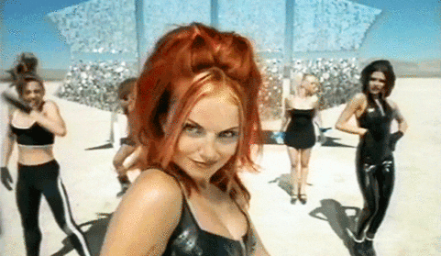
Spacy Girls
Carmen Santana
Itai Soares
Gaspar Pereira
Inês Ribeiro

Slide 3
1. Problem description

Slide 4

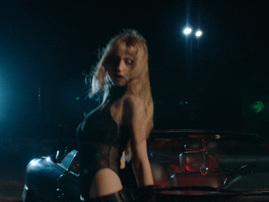
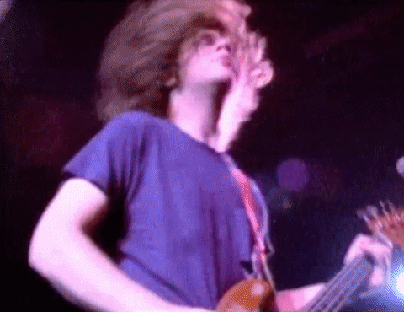
Problem description
Classify song genre based on Lyrics

Slide 5
2. Workflow

Slide 6
2.1 Exploratory data analysis
/ Model Development

Slide 7
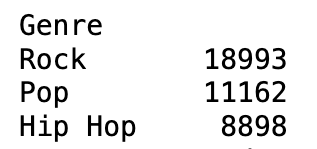
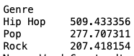
Exploratory Data Analysis
1.
2.
3.
Slightly
unbalanced data
Hip Hop has more words, on average
Hip Hop uses more Adjectives
Genre
Hip Hop 24.670038
Pop 13.236069
Rock 10.541357
Train-test split with stratify
Feature added to model
Feature added to model

Slide 8
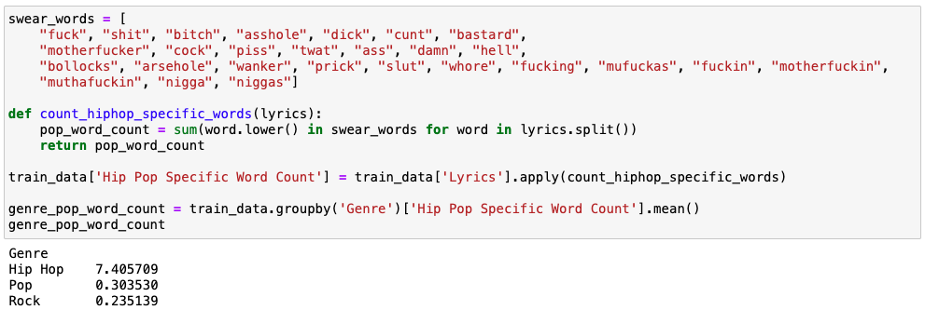
Features
Hip Hop has more swear words (average)

Slide 9
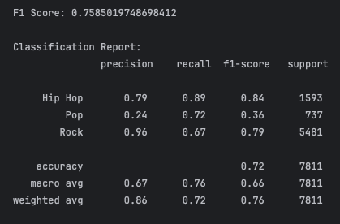
Baseline Model
Preprocessing:
Punct / stopword removal
Vectorizer: Tfidf
Features eng + StdScaler
Random Forest Classifier
Pop songs:
lowest f1-score
Nb_words
Doc_lenght
Swear_words_count
Adj_count
Avg_sentence_length
unique_word_count

Slide 10
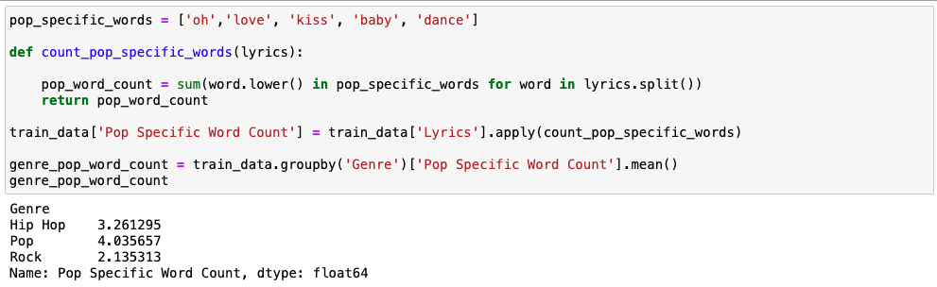
New Features
Pop has more romance words (average)

Slide 11
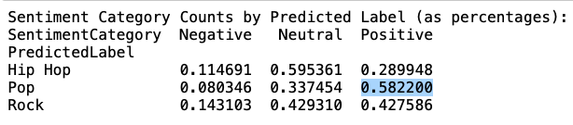
New Features
Pop has a mode Positive sentiment!
using TextBlob

Slide 12
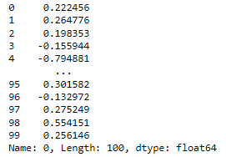
Vectorizers
Doc2vec (100 feats) TfidfVectorizer
ngram_range → 2
min_df → 4

Slide 13
2.3 Results and discussion

Slide 14
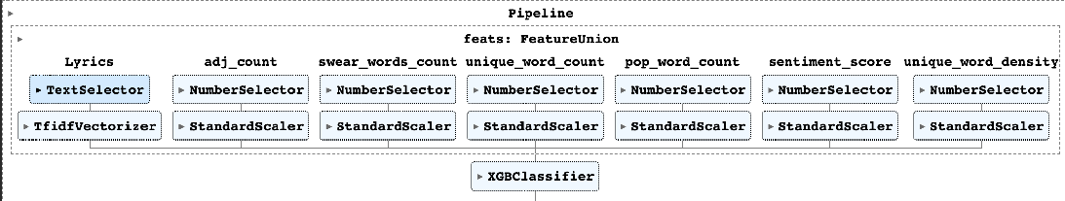
Final Model

Slide 15
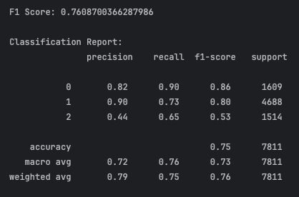
Best Model Results
Test F1 score:
71,3 %

Slide 16
3. Future Work

Slide 17
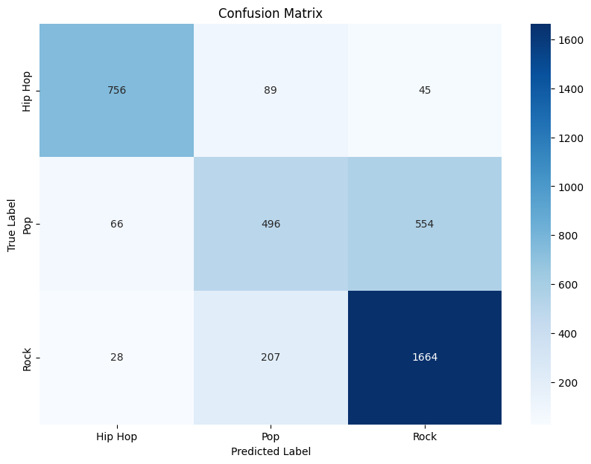
Discussion
Our model rocks at identifying Rock.
But it's confusing Pop with Rock quite often.

Slide 18



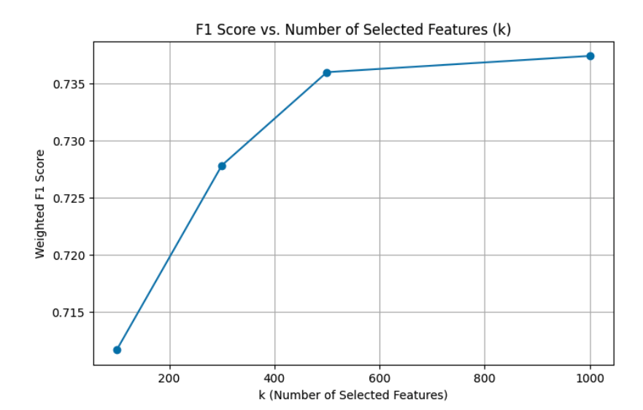
Future work
Feature Engineering
(e.g. number of singers in song)
Investigate Pop & Rock confusion
SelectKbest(500)

Slide 19
Do you wannabe a pop song?
But you rock!

